Slide 1
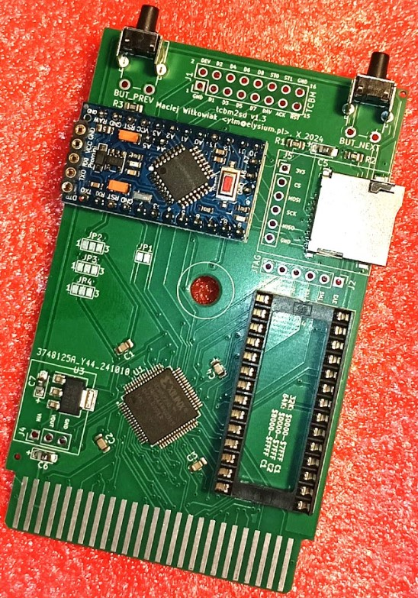
tcbm2sd
C16/116/Plus4 cartridge
1551 paddle replacement
1551 disk drive simulator
Notes:
Thank you everyone. My name is Maciej, I’m going to present you my project: TCBM2SD.
That’s probably easier to write than pronounce, sorry for that.
It’s a cartridge for C16/C116/Plus4 that simulates a Commodore 1551 disk drive so that you can use SD cards for storage
It can be also used as a replacement of the paddle cartridge.
We will talk what a TCBM and paddle is in a moment
The last function is just being a plain cartridge with an EPROM

Slide 2
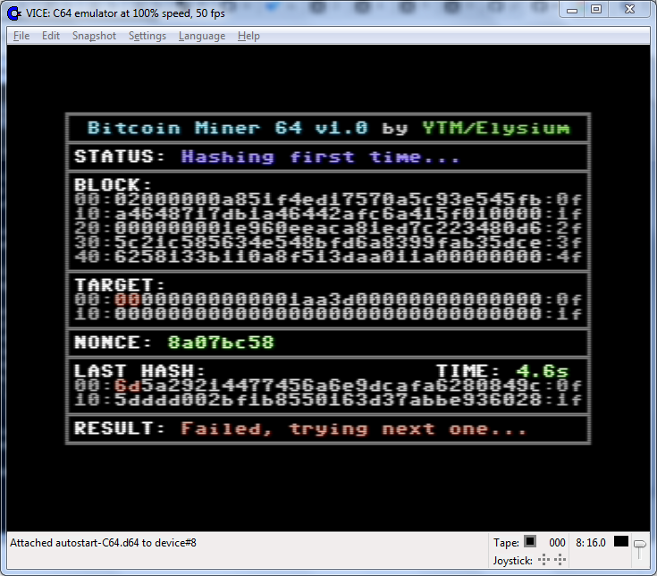
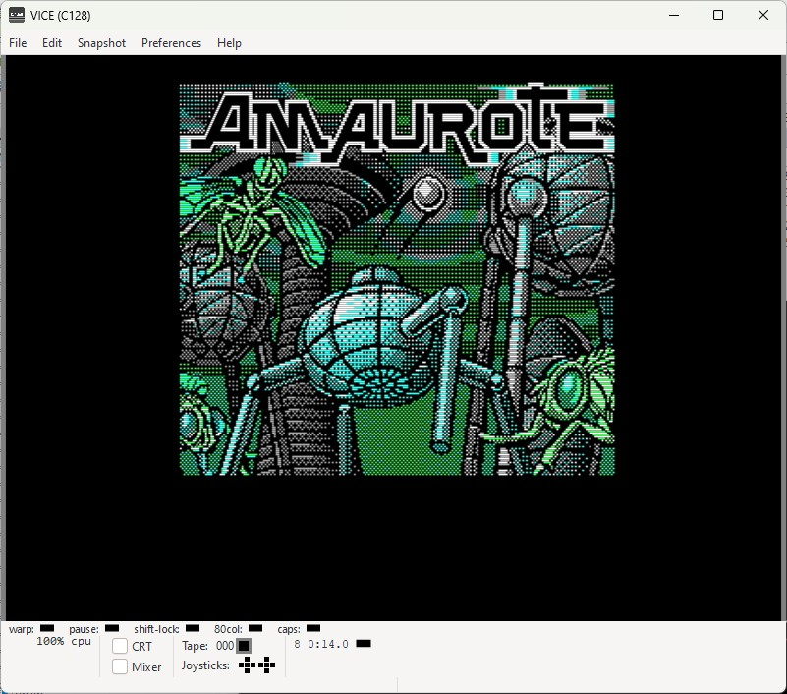
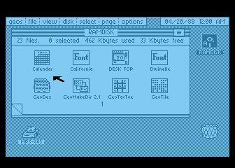
A little about me
Involved with C64 and C128 since 1992
GEOS, C128, hardware
Paused C= activity in 2001
Came back in 2021
Became Plus/4 owner in June 2024
Notes:
First let me introduce myself. My name is Maciej Witkowiak
I have been involved with Commodore C64 and 128 since 1992
My interests were focused on niche topics like GEOS and C128. I have disassembled GEOS back in 2000, I wrote GEOSLib for cc65 C compiler
I tried also various hardware expansions. I was not being able to manufacture my own PCBs, so that was quite difficult, but I managed to install an IDE disk drive in my C128 and use it with GEOS.
I have ported Lunix to C128. There’s a screenshot. First operating system for 8-bit computers with TCP/IP stack. I had it on local home network with its own IP
I paused my activties with 8-bit computers in 2001. But I kept all the hardware and floppies.
Came back in 2021 with bitcoin miner. There’s my scene handle YTM or Yattaman of Elysium
This also happened, Brush of Elysium ported Amaurote from Atari to C64 and later I have ported that game to C128 to make it run in 40 or 80 column mode; faster, to its extra capabilities to speedup that game, not just due to 2MHz mode but also various MMU tricks, zero page remapping etc..
There was also that: a GEOS port for 8-bit Atari. I wanted to check something and I ended up with a complete port.
But that’s not today’s topic. Because in June 2024 for the very first time I became a Plus/4 owner

Slide 3
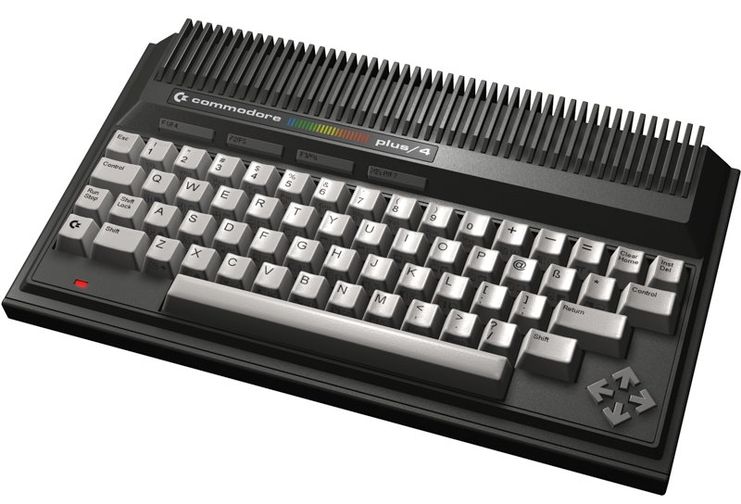
The problem
Newbie: how to do anything?
1541 is SLOW!
SD2IEC faster but still SLOW!
Ultimate II+ not convenient to control
Tapecart – no disk images
I want SPEED
I want CONVENIENCE
Options?
Notes:
That presented a problem. Because I’m a newbie with this computer, so how do I do anything? How do I use the downloaded software or disk images?
With 1541 disk drive? That’s slow and I would have to copy images to magnetic media. Some people enjoy that, me not so much
So maybe SD2IEC? That’s faster but still slow, there are no turboloaders and I didn’t have JiffyDOS
Ultimate II+ is nice but I would have to use a second computer and telnet connection to swap a disk. Not convenient
There is also tapecart. That’s very fast, but doesn’t support disk images. And I don’t feel like extracting their contents to files every time
So these are my problems – I wand speed and I want convenience.
So what can I do? What are the options? I started research on the topic because I knew that for Plus/4 there was a special disk drive with some unusal features.
Let’s take a look first at the native Commodore solution as a starting point to explain the TCBM part of my project’s name

Slide 4
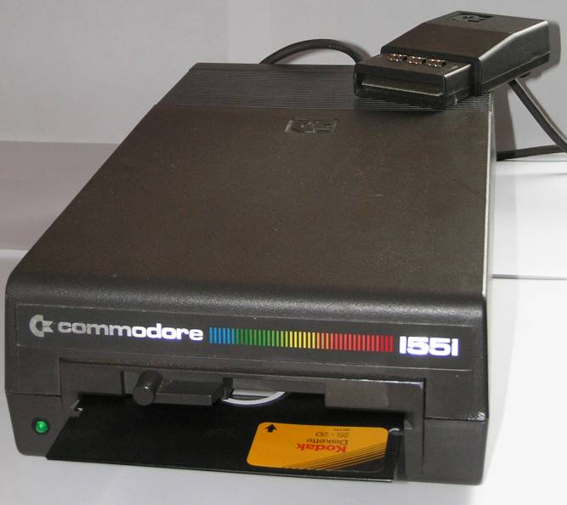
Native solution: Commodore 1551
Designed for C16/116/Plus4
Graphite finish
Almost the same DOS as 1541
Four times faster than 1541
Parallel data transfer (TCBM)
Connected through a cartridge?!
Can I have one of those?
Notes:
So that’s the native solution for C16/116/Plus4 line of computers. Commodore 1551 disk drive.
Designed for these computers. Even has this cool graphite finish to match.
Internally it has DOS almost the same as 1541.
I don’t own one, so I have to trust the sources that it’s about 4 Times faster than 1541. Why? Internally it’s the same
The reason is paralel data transfer over something called TCBM bus. 8 bits of data go in one step. Just like paralel cable for 1541. That explains the „four Times faster” part.
So look at the picture. The drive is connected to the computer via a cable attached to a cartridge
How weird is that?
So let’s take a closer look on that cartridge to understand what’s going on

Slide 5
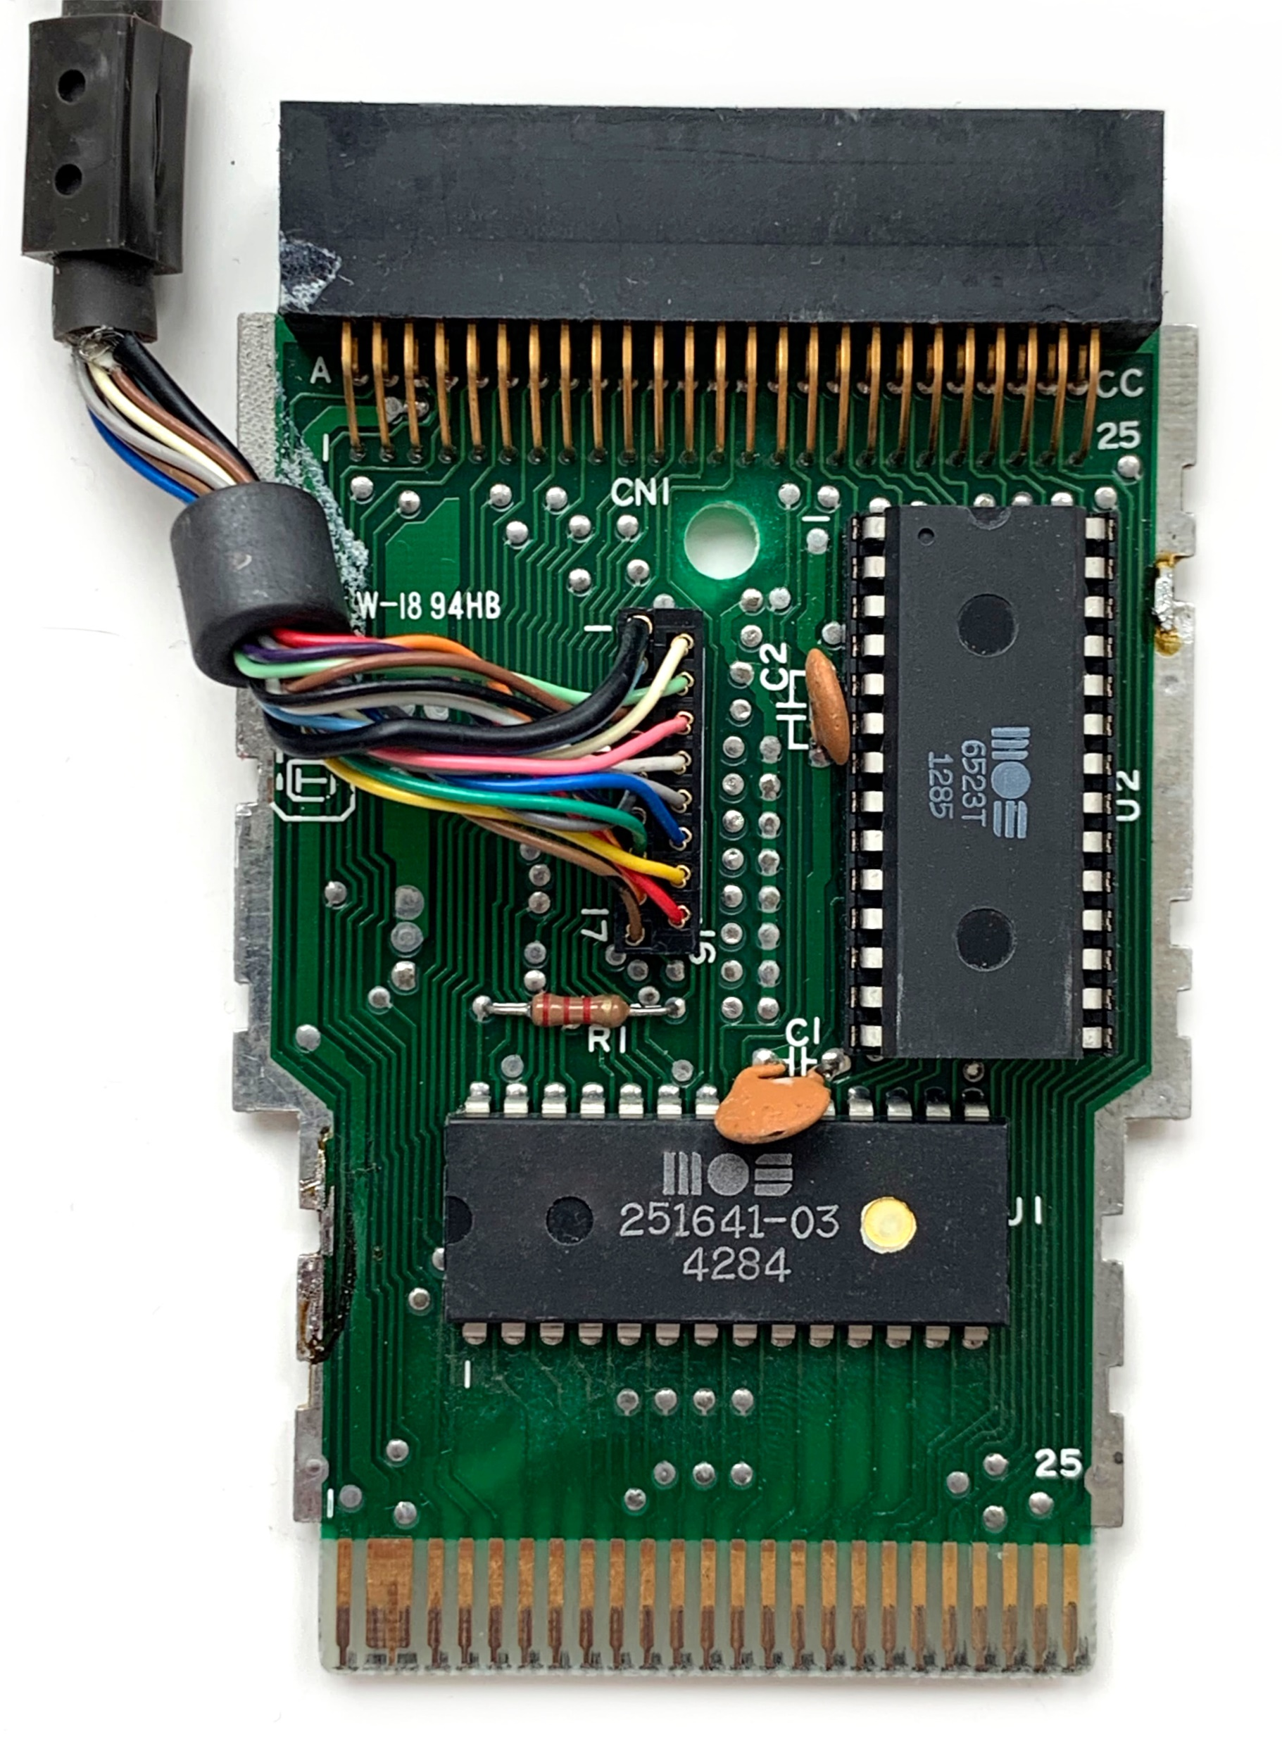
1551 Paddle
Cartridge port passthrough
TCBM cable connector
6523T tri-port interface
A (8 bits), data I/O
B (2 bits), drive status
C (2 bits), handshake
PLA for address and CPU bus decoding
Extensively explained in Michael Stil’s article https://www.pagetable.com/?p=1324
Notes:
So that’s the cartridge. Not only it looks weird, but its official name was „a paddle”. 1551 connects to the computer via a paddle.
On the top there is a cartridge port passthrough. These connectors are impossible to buy these days, so don’t bother trying. The only source seems to be broken C16 mainboards. I admit I bought one to harvest that port, but didn’t have heart to do it and I reparied the whole computer instead.
Its purpose is to allow connecting a cartridge here or ANOTHER paddle for the second drive. I didn’t find a photo of such setup, but it must have been a bit comical.
The next point of interest is here – we have that cable connector with 17 wires. To the right there is a 6523T triport interface. It’s a trimmed down I/O device which has one full 8-bit port for data and two 2-bit ports for drive status and handshake lines.
On the bottom theres a PLA chip that handles adress and CPU bus decoding. That puts this port chip somewhre in the I/O address space, depending on the device number.
Oh, by the way – only two devices can be attached this way: numer 8 and 9. And there are no switches for that anywhere here, you would have to open 1551 drive for that.
All of that to make the computer itself cheaper

Slide 6
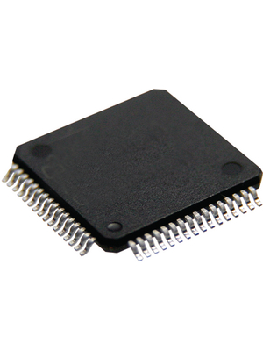
Research results
No 1551 emulator (U2+ / Pi1551)
No SD2IEC for TCBM bus
No other device that would understand TCBM protocol
PLA has been replicated
„Big” 40-pin 6523 has been replicated too: Fake6523 by Jim Brain
Idea
Start with something simple
Replicate the paddle part
Connect it to something that would talk TCBM
Simulate (not emulate) 1551/TCBM device
SD2IEC + TCBM at some time in the future?
Notes:
All right. So usually when you come up with an idea it turns out that it’s already available because someone did it and it’s there in the internet.
Here I was hoping for SD2IEC that would support this kind of paralel connection. But there is nothing like that, nor even attempts
In fact there was no device at all that would understand this protocol.
But parts of the paddle have been replicated. The PLA has been replicated, it can be easily replaced with an EPROM.
The port part was also replicated. That chip has a bigger brother 6523 in a 40-pin package with all ports being 8-bit. So there’s Fake6523 project by Jim Brain.
All right, so it looks like I can do something new. So it’s clear that I need a cartridge first. The paddle part.
I would connect it with something that would understand and talk over that TCBM connection.
I don’t have clear vision, I want to try something simple first.
Can I use SD2IEC codebase for that? Maybe, but not yet. Not a good starting point really for two reasons. One is that the codebase is complex and I don’t know if I even have
all the information needed for the communication part. The second reason is that SD2IEC needs one of the larger microcontrollers and they don’t come in ready to use Arduino modules
with all the I/O pins broken out. I wanted to play safe, to solve one problem first: communication and then deal with other stuff.
I don’t want to put too much effort for unknown reward. At that stage I was still unsure if all of this makes practical sense.
So let’s start with a simple prototype

Slide 7
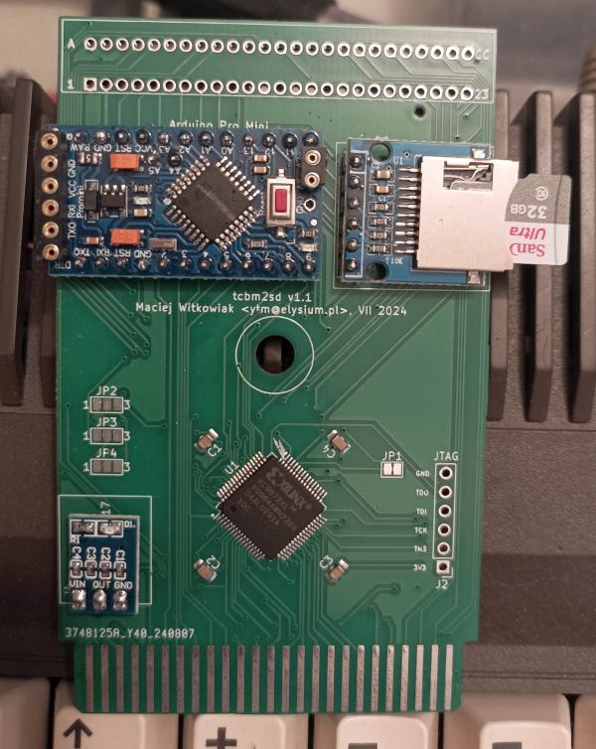
tcbm2sd v1.0/v1.1
Arduino Mini Pro
CPLD XC9572XL
3.3V power module
SD card socket module
Expansion port edge connector
Notes:
All right, so here is the design of the 1.0 and 1.1 revisions that were done between June and August 2024.
As you see except for the CPLD chip and its supporting capacitors all of that was done with Arduino modules, almost like putting together building blocks.
We have the Arduino Mini Pro itself, that’s 8MHz microcontroller, with 28K of usable flash and 2K of RAM. It has plenty of I/O lines and they work at 3.3V logic
There is the CPLD chip initially I have soldered these by hand, and that as a first for me too. The holes to the right are the JTAG interface to flash it.
Here is the 3.3V power module. This turned out most time consuming because I had to remove original pins in order to be able to put that board in paralel with main PCB
Next one is SD card socket. Sadly it doesn’t have spring inside to eject the card and it doesn’t expose the card sensor. So DOS Initialize command had to be used to reset the card contents, it couldn’t be autodetected
Finally on the top there is the place for expansion port. I had no idea that this part is impossible to find.
Then we have the logic level, stuff that lives inside CPLD chip. There is PLA address decoding for device 8 or 9 so that they appear in correct place in I/O space.
There is the port itself to make communication between Arduino and computer possible. And there is CPU bus decoding part, that decides when the port is being accessed by the procesor. That was the tricky part that I didn’t get right in the beginning even after first release of the project.
Ok, the last layer is the software part. So Arduino has to understand the basic TCBM protocol commands: send byte, receive byte. On top of that we have the layer of bus commands
Like LISTEN and TALK and the concept of channels, including channel 15 for DOS commands. Then on top of that support for directory listing, loading and saving files can be built
When all of that was more or less working I saw how much flash and RAM was left and I manager to squeeze in also fastloader and disk image support.

Slide 8
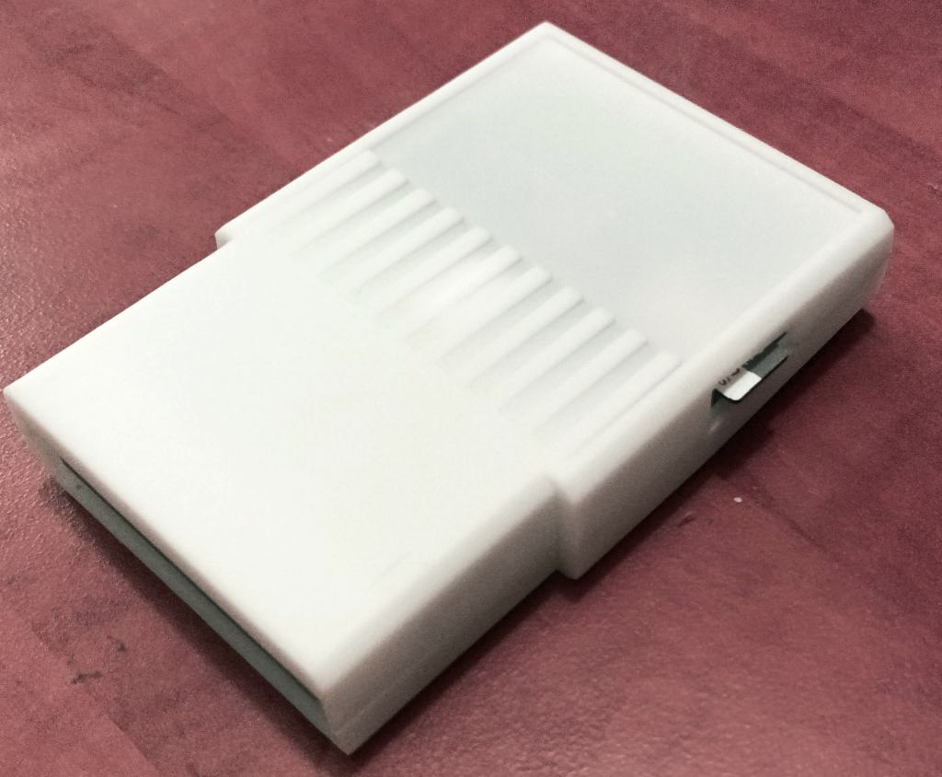
tcbm2sd v1.0/v1.1
Stylish (should be graphite)
Convenient
Fast
No need for SD2IEC/TCBM
Firmware problems
Some missing features
Notes:
That’s how it looked like when put into a standard C16 cartridge shell with a slot cut on the side. Stylish! But I made a huge mistake to order these 3d prints in cheapest white instead of graphite matching Plus4 case.
This is the moment where I dropped the idea of making changes in SD2IEC – that thing was fast and convenient.
But there were things to fix. Soon I got reports that there are issues on computers with replacement parts like CPU replacements or JiffyDOS.
And after using this for a while I saw what is missing, what could be improved.
So a redesign was needed.

Slide 9
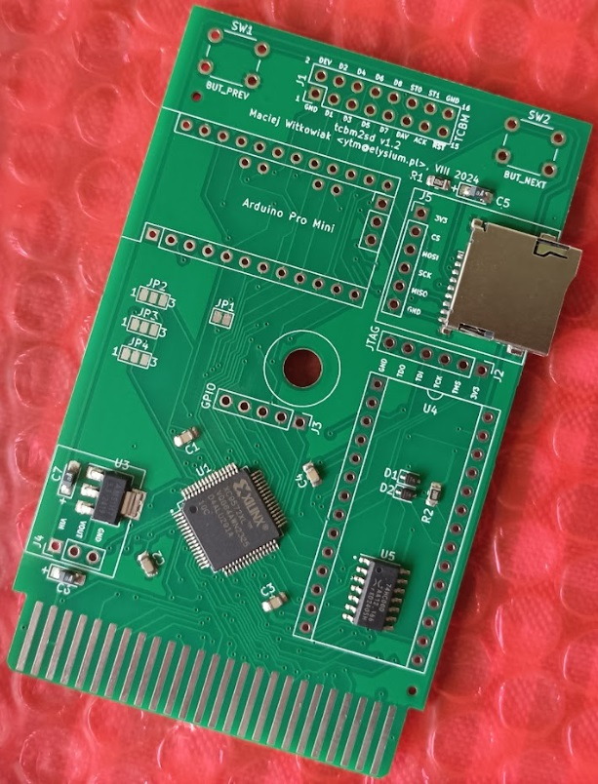
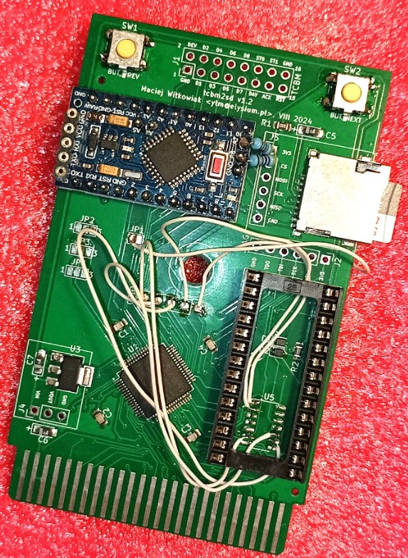
tcbm2sd v1.2
Notes:
This is the second revision, a prototype. On that photo it’s not completely assembled.
As you see the expansion port passthrough is gone. In that place there is space for push down buttons.
There is a place to connect the cable to a real 1551 even if Arduino is installed (earlier it was underneath it). The arduino will disable itself when a cable is connected.
There are no modules here, because I have ordered this board with components assembled. But it’s not necessary – this board can be still built using modules, there are still the connection holes for that and they are in exactly the same place as before.
Under the hole for the screw in the middle there is another connector – that was for debug purposes.
Finally a place for ROM socket is here. To make 32 or 64K EPROM work you need to combine logic signals so I have added a second chip with NOT-AND gates, two diodes and a resistor for AND gate.
Which was silly because I have a whole logic chip next to it. So this is an assembled board with that chip with NOT-AND gates removed and a bunch of wires connected to former debug port.

Slide 10
tcbm2sd v1.3
DIRECTORY, DLOAD, DSAVE
subset of disk commands
disk images: D64/71/81/82/80
programmable device 8 or 9
fast (2x1551, 6x1541)
fastloader (6x1551, 23x1541)
32K / 64K cartridge (1 or 2 32K banks)
Notes:
And this where we are today. This is the current revision, the one available from Github right now.
The logic gates chip is gone, and the buttons are angled. This is because push buttons put a strain on the cartridge port when there is no support from the bottom.
I don’t have a nice photo of that board in a case because there isn’t one right now, I’m no 3d designer.

Slide 11
DEMO
Notes:
Running +4 with just the cartrige connected; two 32K cartridge images: octabasic + calcplus, RESET
DS$
DIRECTORY or DIR, show BOOT.T2SD
DLOAD”*, same as SHIFT+RUN/STOP
F7 in browser, ESC
Directory navigation
GAMES/B, load BOULDER
RESET, DIR, OPEN15,8,15,”CD<-, DIR, SHIFT+RUN/STOP
PATCHED, various types, enter/exit image, startup LEMMINGS, RESET, DIR, startup TURBO
RESET, SHIFT+RUN/STOP, GEOS, next,next,next, C=+O, C=+7, C=+Y
stop

Slide 12
What comes next?
continue software patching, highly rewarding and fun
Maybe Pi1551?
cycle-exact emulator, capable of running drive code in realtime
hardware much simpler than Pi1541
no voltage level shifting, it’s all 3.3V logic
just connect some wires to Raspberry Pi GPIO
help needed
Notes:
Where to go from here:
I’m satisfied with the hardware – my goals were achieved
Circuit design, PCB design are easy, tool are excellent, manufacturing is easy and cheap
Patching hardware via firmware is easy
Good hardware design is hard! Even with great planning obvious things can stay under the radar:
ROM socket is an obvious thing to have on cartridge, but I was focused on replicating paddle
Instead of next/prv buttons (SD2IEC) I put unobtainium Expansion Port connector
Unused pins can be used via firmware update but they must be exposed
Not going to:
develop this further from hardware or firmware side
revisit SD2CBM idea based on SD2IEC codebase
Going to:
Continue with software patching, it’s quite easy with high reward
Hoping to:
Eventually start Pi1551 project where a RPi would run a cycle-exact emulator of 1551
Pi1541 already works, 1551 is very similar to 1541
TCBM connector on the TCBM2SD already has 3.3V levels, no extra hardware needed

Slide 13

Where to get it?
Firmware, software, hardware designs, patched games
https://github.com/ytmytm/plus4-tcbm2sd
Will be also published on PCBWay
Want to purchase? Contact me.
Notes:
How to get one of these.
All the information is published on github. There is Kicad project there with schematic and PCB design, bills of materials and other documentation.
There is firmware, software available. Also all the patched games and source code for the patches, so it’s easy to add more of tchem.
This will be also published on PCBWay, so you can order the board and they will put all of the stuff together. But I guess you have to flash the firmware on your own. I don’t know
Now, if you’re not capable of building this on your own and you just want something ready to use immediately – contact me. I might have some spare units left and if there’s enough
Interest I can order more. You can find my email address easily, it’s in plenty of places over the internet.

Slide 14
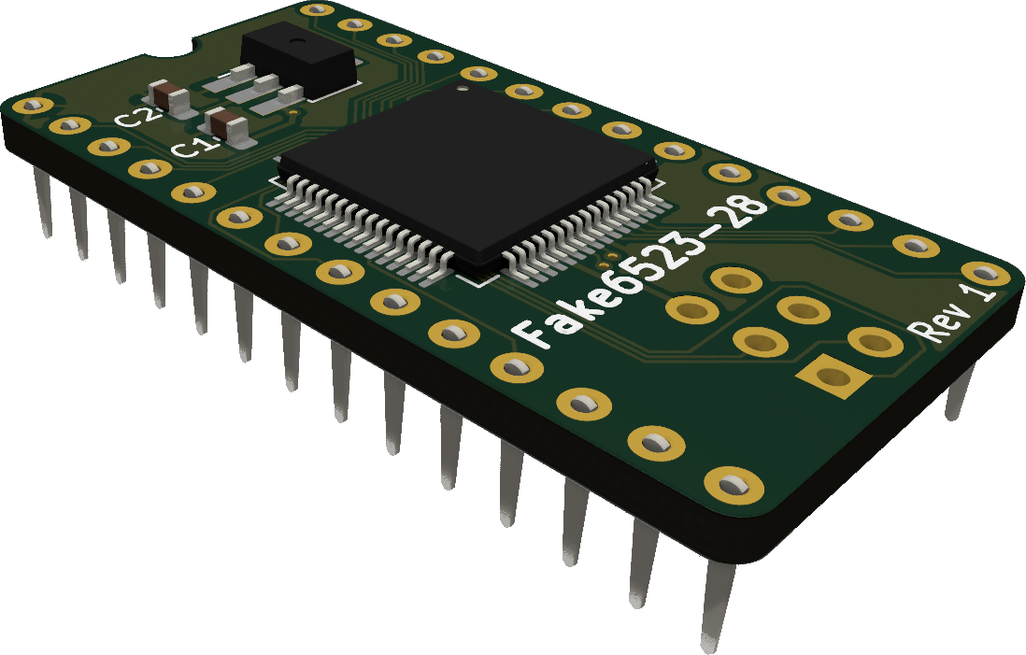
This project wouldn’t be possible without people who made a choice
to make an effort to open source their hardware and software projects.
There is a project based on tcbm2sd already:
https://github.com/RetroNynjah/Fake6523-28
Thank you!
Notes:
Ok, that’s the end of my piece. I want to thank you for your time and attention. And for the opportuinity of presenting it here today.
I want to say that a project like this wouldn’t be possible without all the people who made a choice in the past. Their choice was to document and open source
their hardware and software projects. I could complete this within such short timeframe only because there was plenty of information and examples out there.
There is a project based on my work already: Per Bengtsson has produced a modern replica of the small triport chip as a standalone product. That can be used to repair broken paddles.
Just wanted to send greetings also to the awesome community over there at plus4world forum. These guys are super nice.
Ok, that’s it from me.

